Slide 1
User Defined Package
Course Code: CSC 1205
Course Title: Object Oriented Programming 1
Dept. of Computer Science
Faculty of Science and Technology
Lecturer No: | 19 | Week No: | 10 | Semester: | Summer 19-20
Lecturer: | kawsur & kawsur@aiub.edu

Slide 2
Lecture Outline
Introduction to User Defined Package
Create a Package
Hierarchy of packages
Naming Convention
Finding Packages and CLASSPATH
Import Packages

Slide 3
Introduction to User Defined Package
What is Package
Packages are a feature of the Java programming language that help us to organize and structure our classes and their relationships to one another.
In other words, a package is a grouping of related types providing access protection and name space management.
This is the general form of the package statement:
There are 2 types of packages:
Built-in package: Already defined packages like java.io.*, java.lang.* etc. are known as built-in packages.
User defined package: The package we create is called user-defined package.

Slide 4
Introduction to User Defined Package
Why Packages are used
Preventing naming conflicts.
Making searching/locating and usage of classes, interfaces, enumerations and annotations easier.
Providing controlled access.
Packages can be considered as data encapsulation (or data-hiding).

Slide 5
Introduction to User Defined Package
Access Protection
Java’s access control mechanism may seem complicated, we can simplify it as follows.
 | Private | No Modifier | Protected | Public
Same Class | Yes | Yes | Yes | Yes
Same package subclass | No | Yes | Yes | Yes
Same package non-subclass | No | Yes | Yes | Yes
Different package subclass | No | No | Yes | Yes
Different package non-subclass | No | No | No | Yes

Slide 6
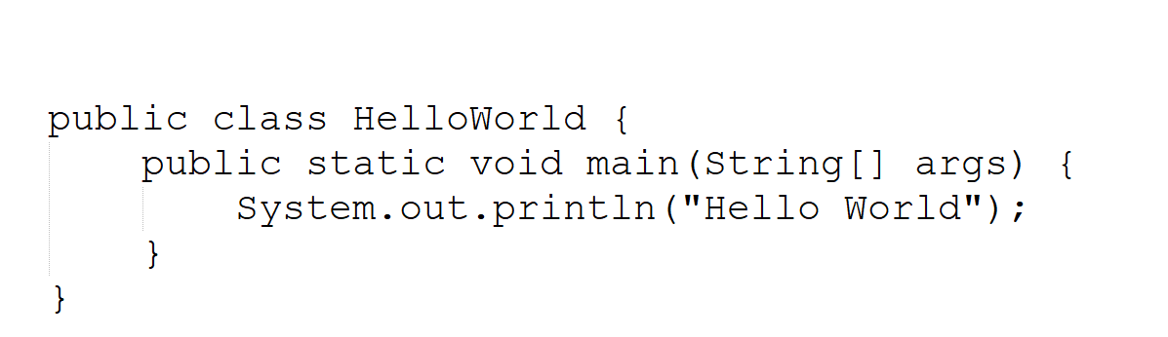

Create a Package
Package Creation Process
To create a package, choose a name for the package and put a package statement with that name at the top of java source file.
The package statement must be the first line in the source file.
There can be only one package statement in each source file.
If you do not use a package statement, your type ends up in an unnamed package

Slide 7
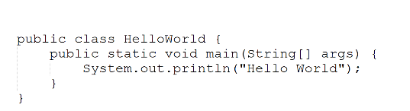

Create a Package
Directories
Java uses file system directories to store packages.
For example, the .class files for any classes you declare to be part of MyPackage must be stored in a directory called MyPackage.
From last example we can say that we have to put our HelloWorld.class file in greeting directory.
D:\greeting
HelloWorld.java

Slide 8

Hierarchy of packages
Example of Hierarchy of Packages
We can create a hierarchy of packages.
To do so, simply separate each package name from the one above it by use of a period.
The general form of a multileveled package statement is shown here:

Slide 9
Hierarchy of packages
Hierarchy
D:\demo\greeting
HelloWorld.java

Slide 10
Naming Convention
Package Naming Convention
The prefix of a unique package name is always written in all-lowercase ASCII letters and should be one of the top-level domain names.
Subsequent components of the package name vary according to an organization's own internal naming conventions
For Example:
com.sun.eng
com.apple.quicktime.v2
edu.cmu.cs.bovik.cheese

Slide 11
Finding Packages and CLASSPATH
Finding Packages and CLASSPATH
As we know, packages are mirrored by directories, so how does the Java run-time system know where to look for packages that we create.
The answer has three parts:
First, by default, the Java run-time system uses the current working directory as its starting point.
Second, you can specify a directory path or paths by setting the CLASSPATH environmental variable.
Third, you can use the -classpath option with java and javac to specify the path to your classes.
Let’s take an example.

Slide 12
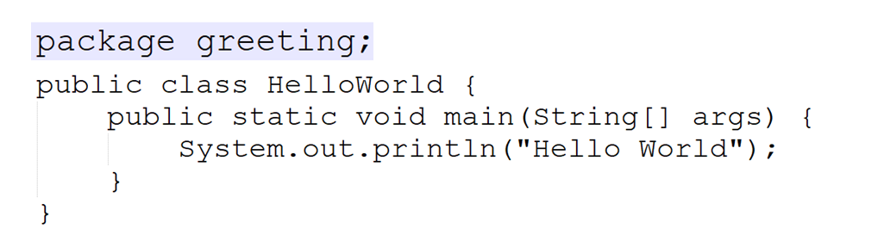
Finding Packages and CLASSPATH
Example Finding Packages and CLASSPATH
Let’s take our previous code. And our HelloWorld.java file location is: D:\MyProgram\Java\greeting
First, we must go above to greeting folder. Which is D:\MyProgram\Java. Now we can compile with the following command.
javac greeting/HelloWorld.java
It will create class file in the greeting directory, Next, we can run the file using the following command.
java greeting/HelloWorld.java

Slide 13
Import Packages
How to import package
Java includes the import statement to bring certain classes, or entire packages, into visibility.
Once imported, a class can be referred to directly, using only its name.
This is the general form of the import statement:
In a Java source file, import statements occur immediately following the package statement (if it exists) and before any class definitions.
In the above syntax, pkg1 is the name of a top-level package, and pkg2 is the name of a subordinate package inside the outer package separated by a dot (.).
Finally, specify either an explicit classname or a star (*), which indicates that the Java compiler should import the entire package

Slide 14
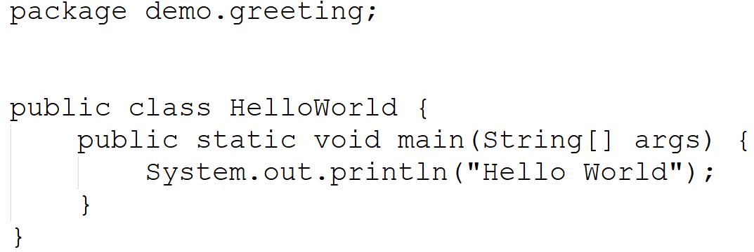

Import Packages
Example of how to import package

Slide 15
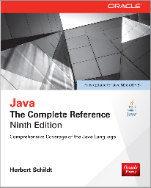
Books
Java The Complete Reference- Ninth Edition by Herbert Schildt

Slide 16
References
https://docs.oracle.com/javase/tutorial/

